Slide 1
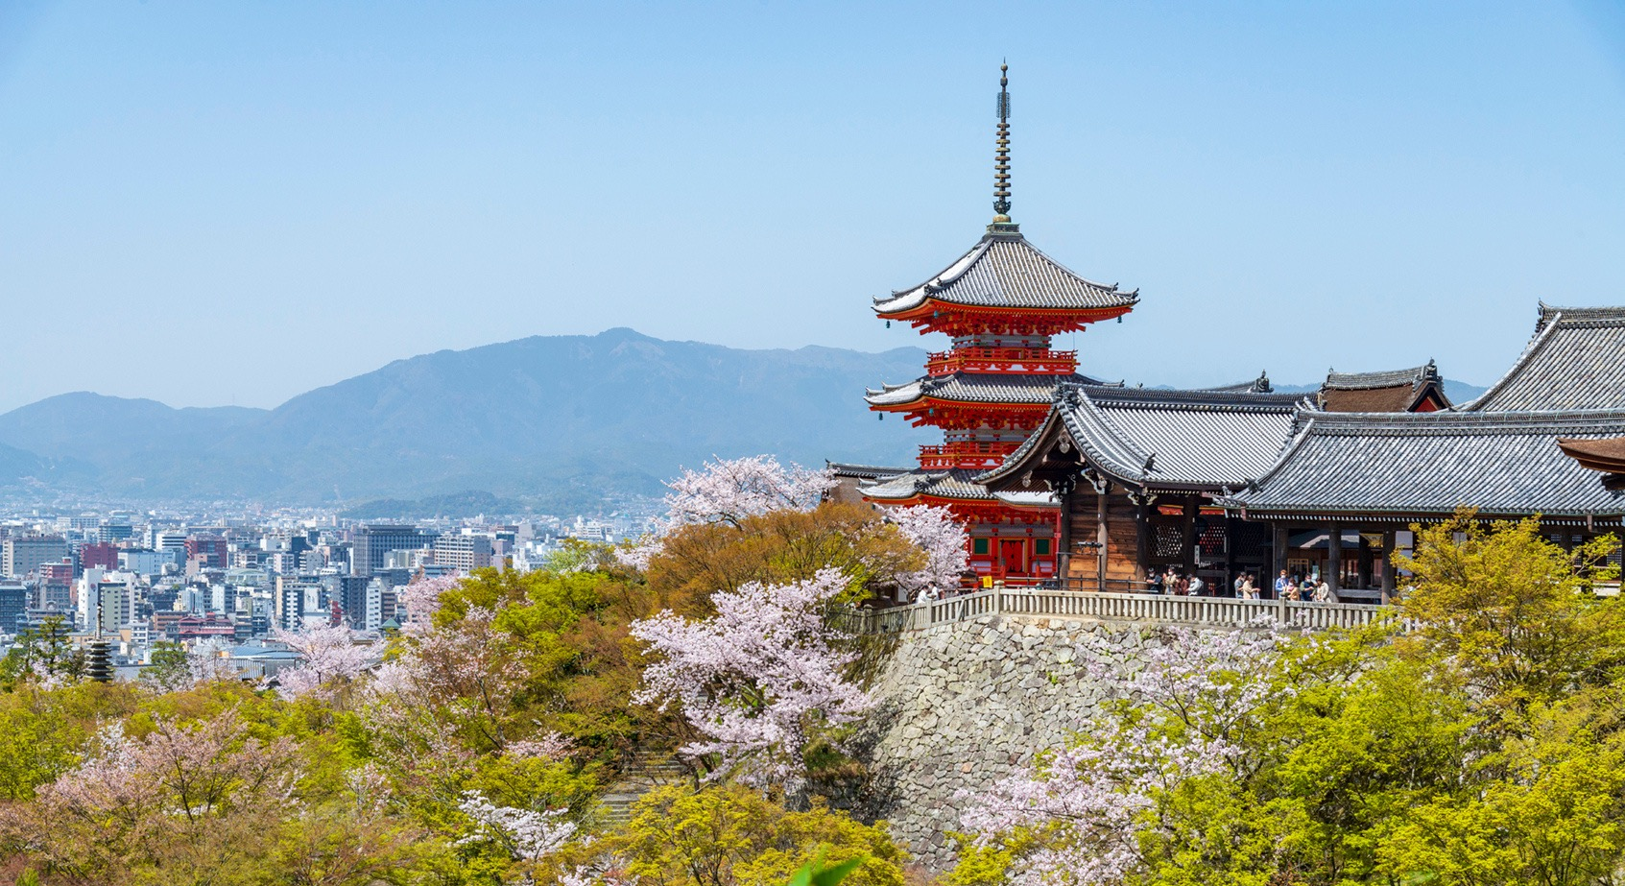
2025 IECEx
JAPAN
Annual Meetings
KYOTO

Slide 2

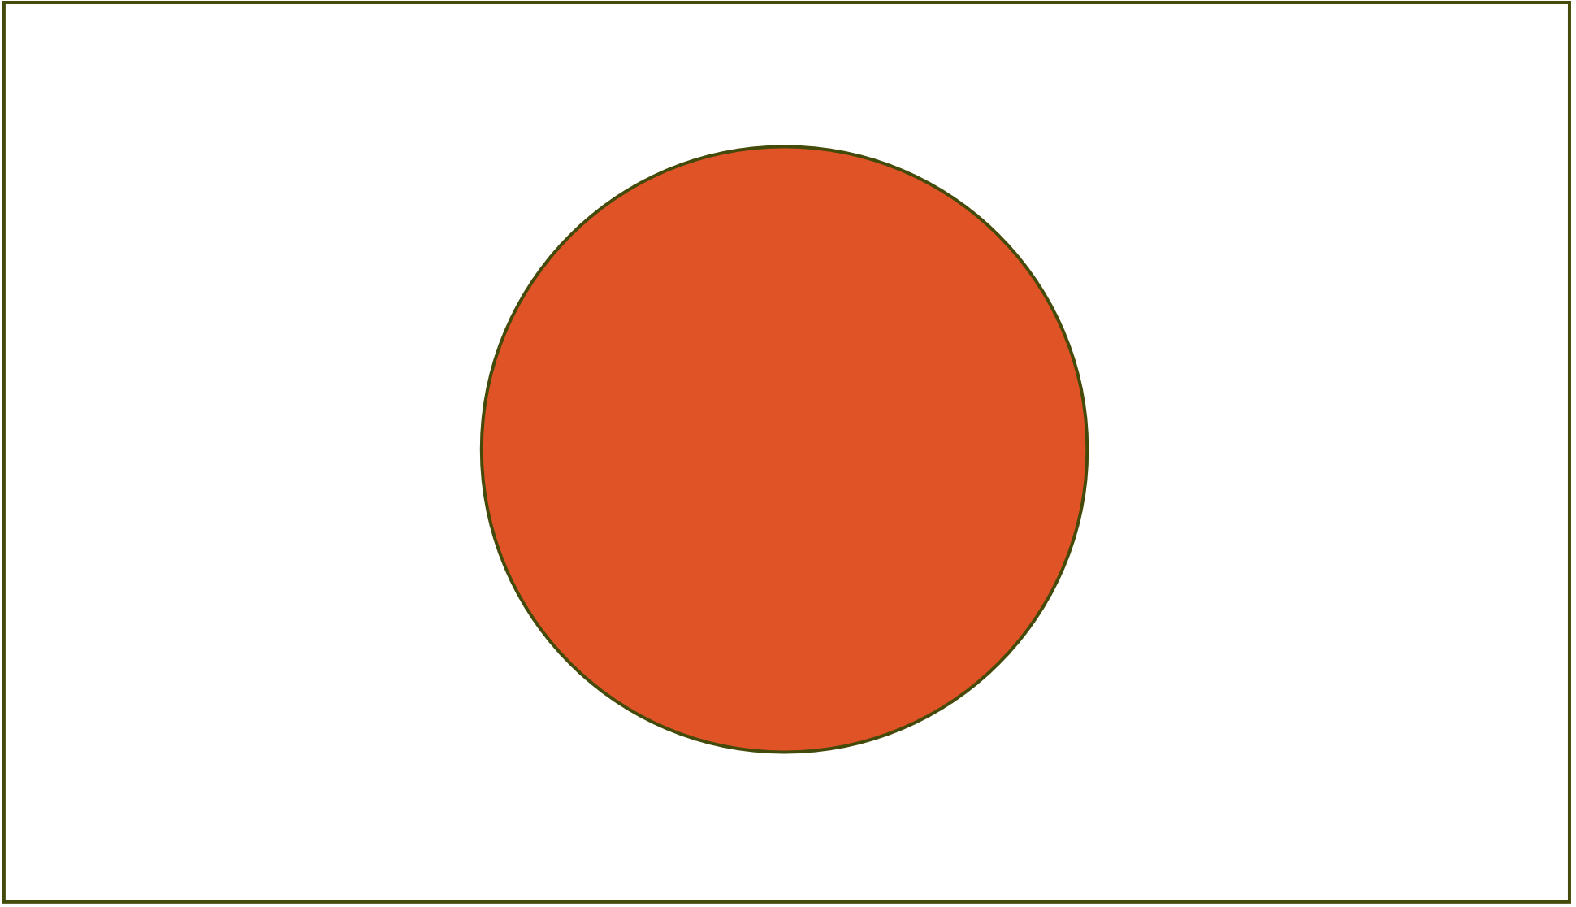
01 COUNTRY&HOST
JAPAN
Technology Institution of Industrial Safety

Slide 3
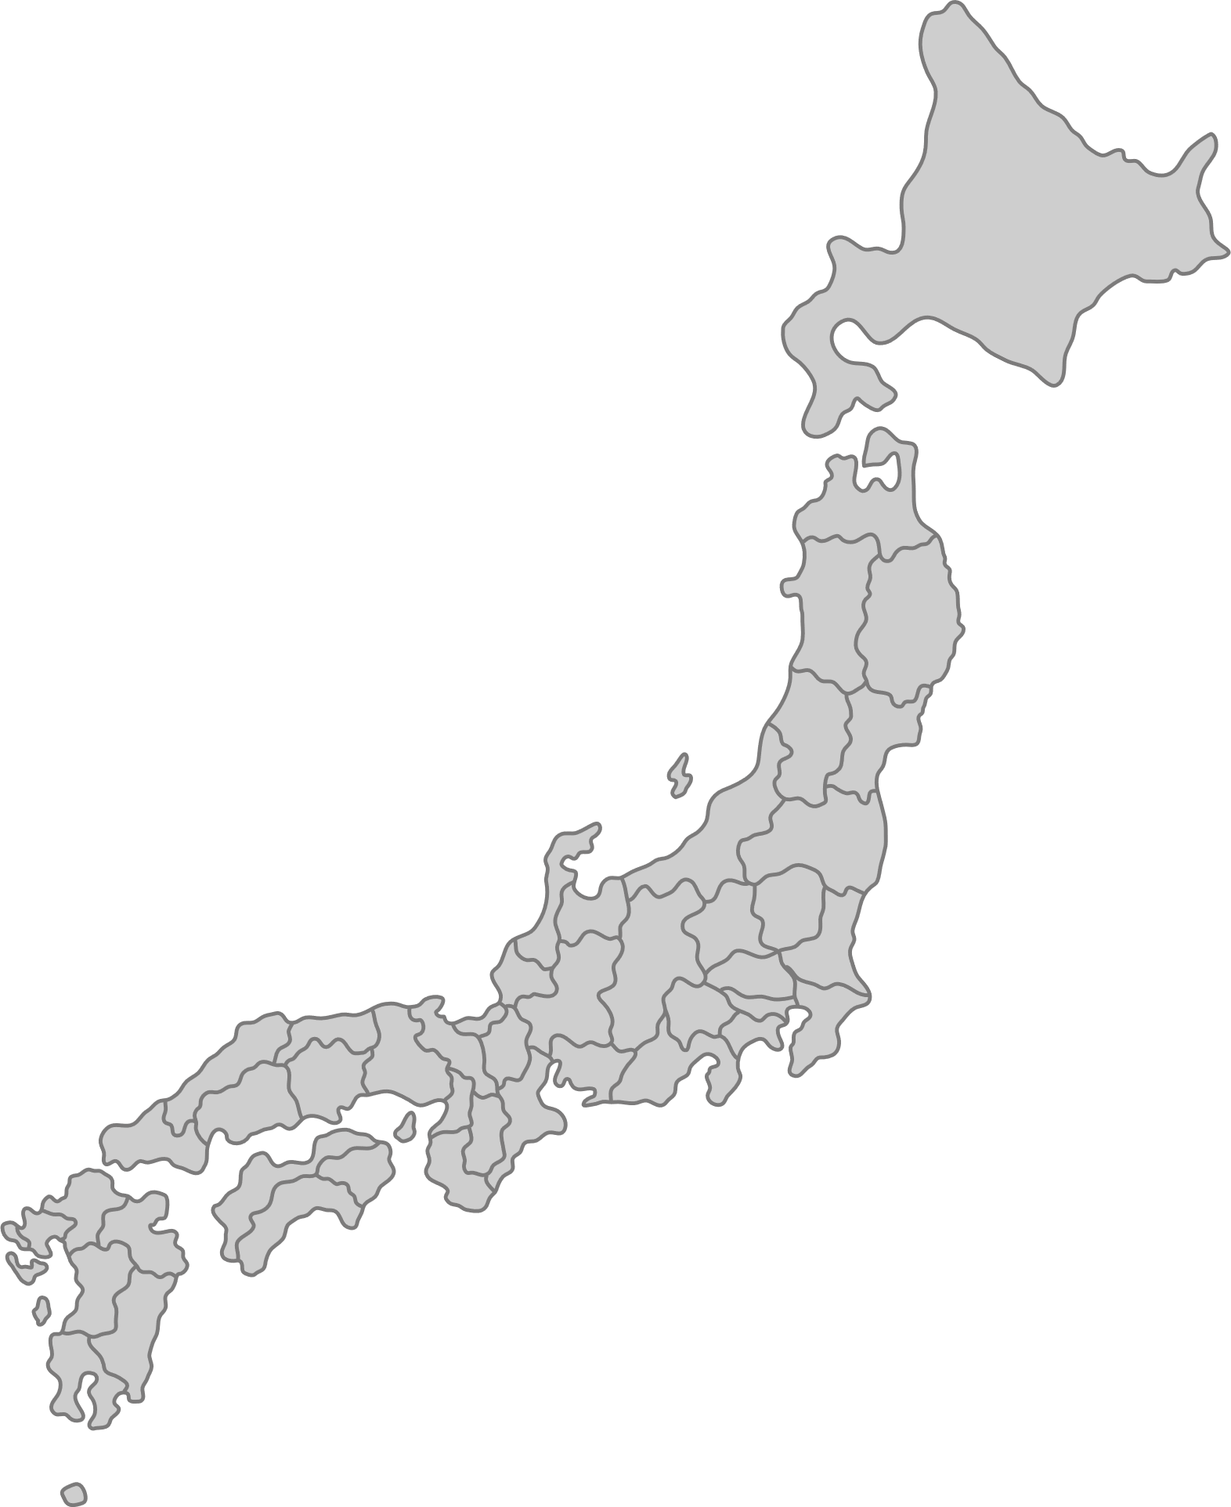

02 LOCATION
KYOTO
  Where is KYOTO?
TIIS
TOKYO

Slide 4
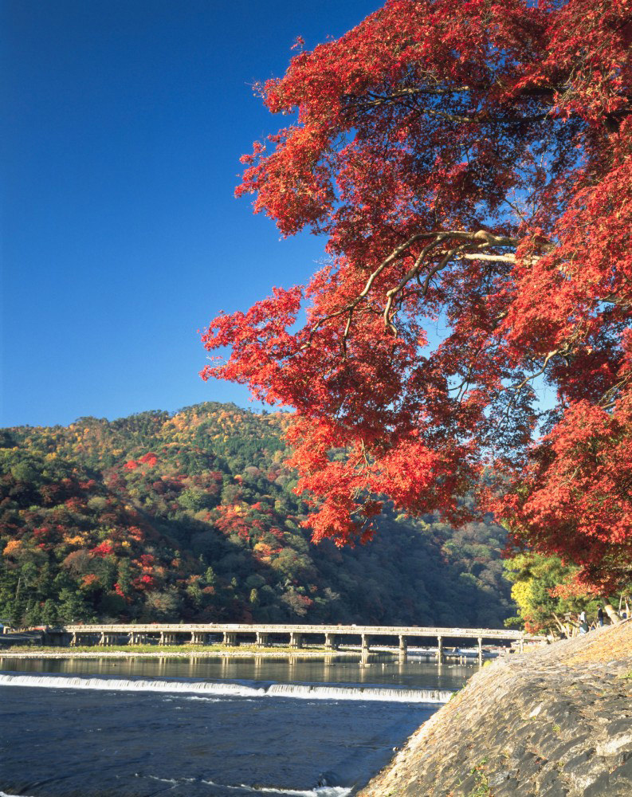
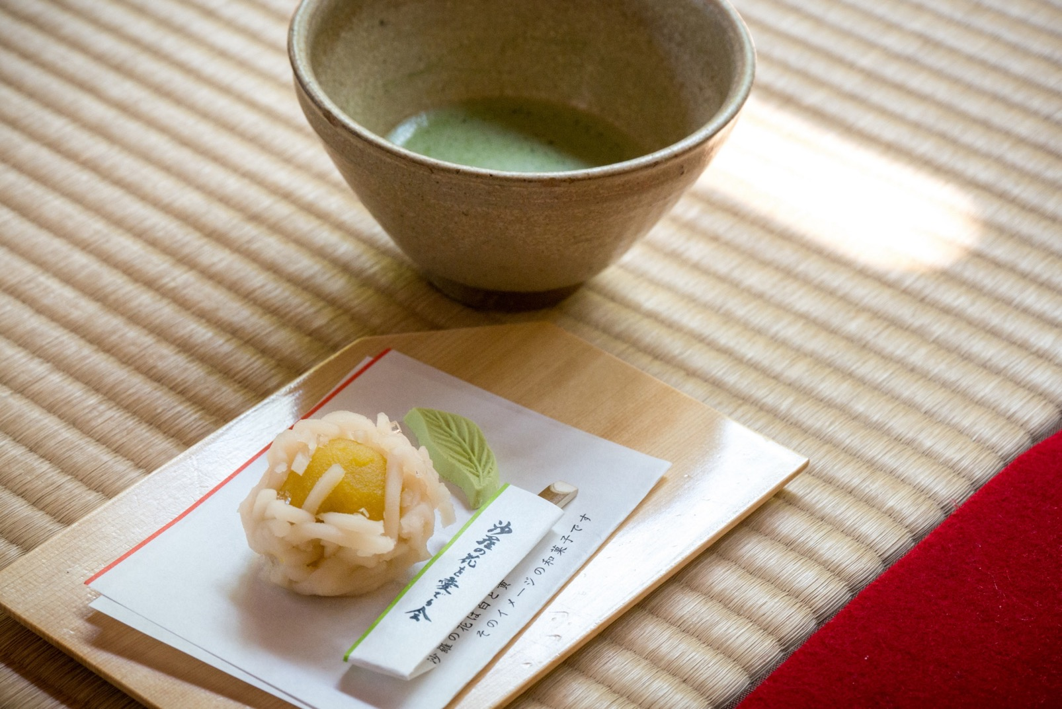
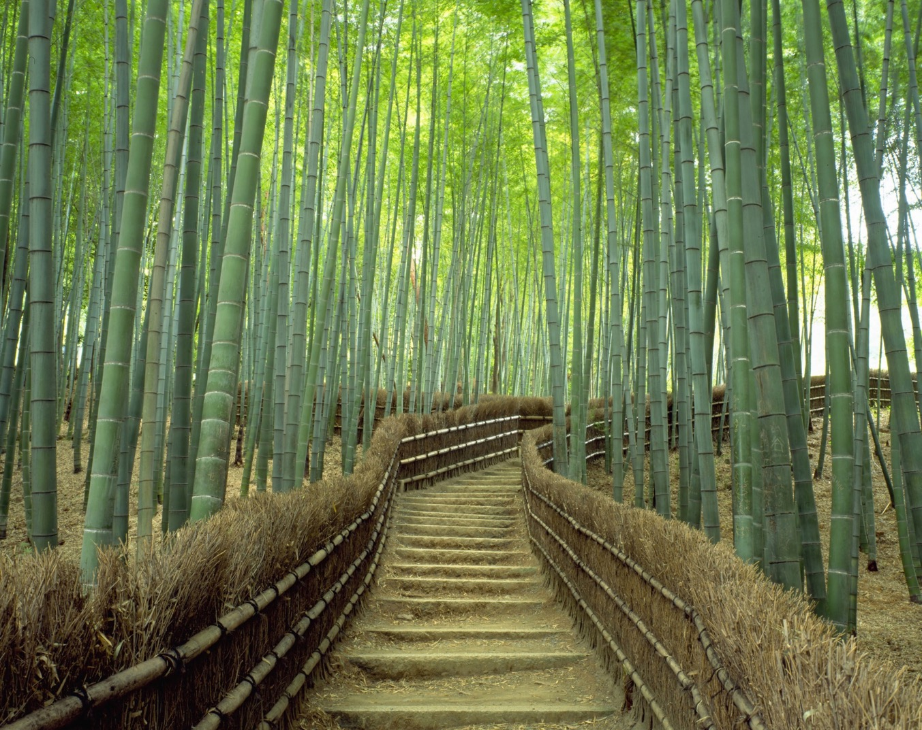

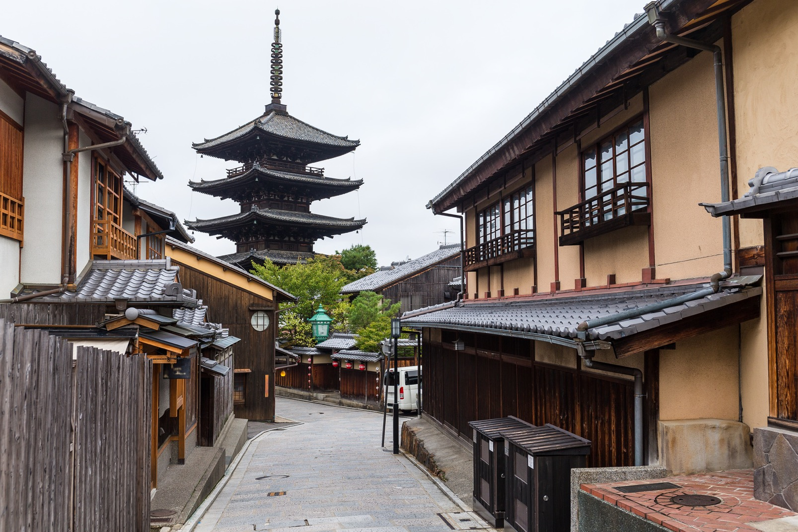
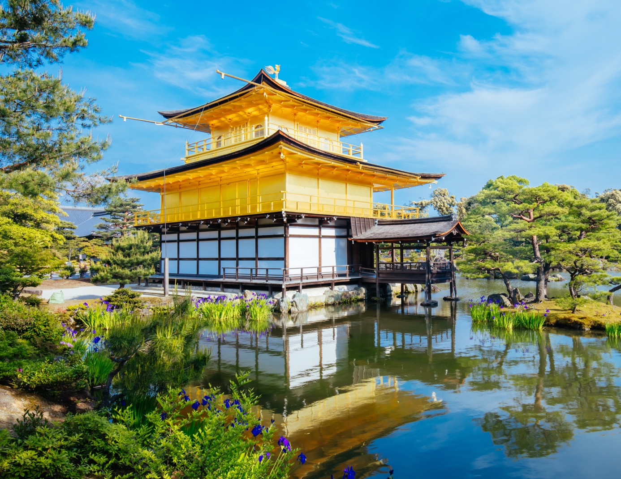
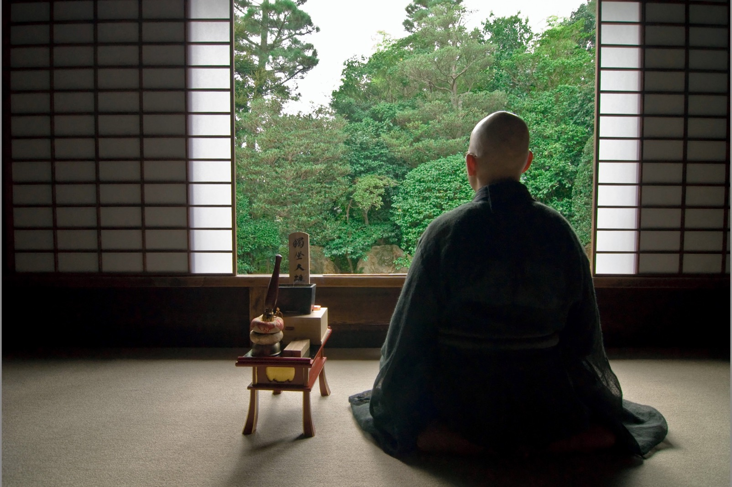
03 What is like KYOTO ?

Slide 5

04 SCHEDULE
SEPTEMBER
2025
SUN | MON | TUE | WED | THU | FRI | SAT
 | 1 | 2 | 3 | 4 | 5 | 6
7 | 8 | 9 | 10 | 11 | 12 | 13
14 | 15 | 16 | 17 | 18 | 19 | 20
21 | 22 | 23 | 24 | 25 | 26 | 27
28 | 29 | 30

Slide 6
04 SCHEDULE
 | 9/15(Mon) | 9/16(Tu) | 9/17(Wed) | 9/18(Thur) | 9/19(Fri)
9:00-12:30 | Assessor Training | ExTAG Meeting | ExSFC | ExMC Meeting | ExMC Meeting
Lunch Break
14:00-17:00 | ExPCC | ExTAG Meeting | Industrial Symposium | ExMC Meeting | ExMC Meeting
17:00/18:00- | WG Meeting | WG Meeting | WG Meeting | ExMC Dinner

Slide 7
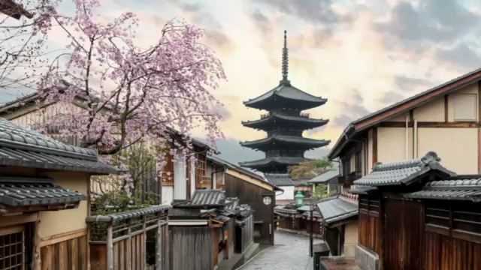
05 VENUE (Click to start Movie)
NEXT

Slide 8
See you in Kyoto!

